Slide 2
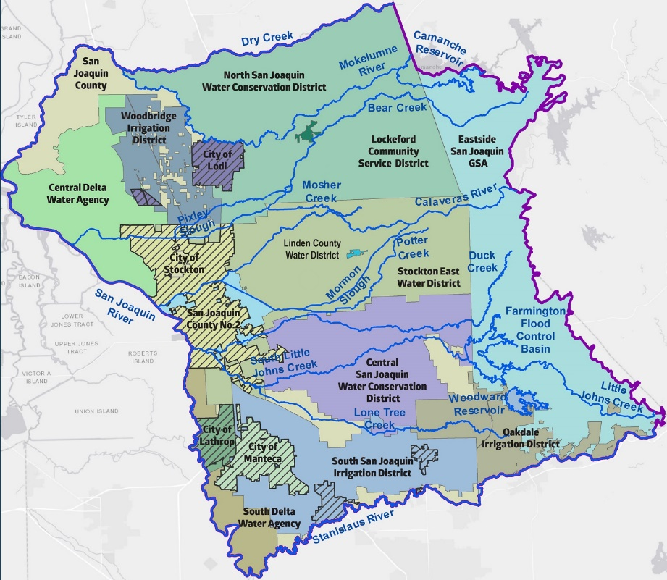
What is the ESJ GWA?
Joint Powers Authority, established to complete a single Groundwater Sustainability Plan.
Includes 17 GSAs in the Eastern San Joaquin Subbasin.
1

Slide 3
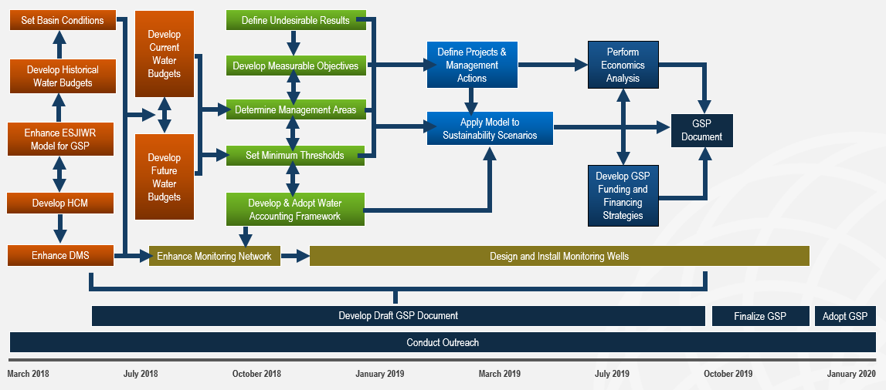
The GSP will be complete by August 2019 allowing for adoption prior to January 31, 2020 deadline
2

Slide 4
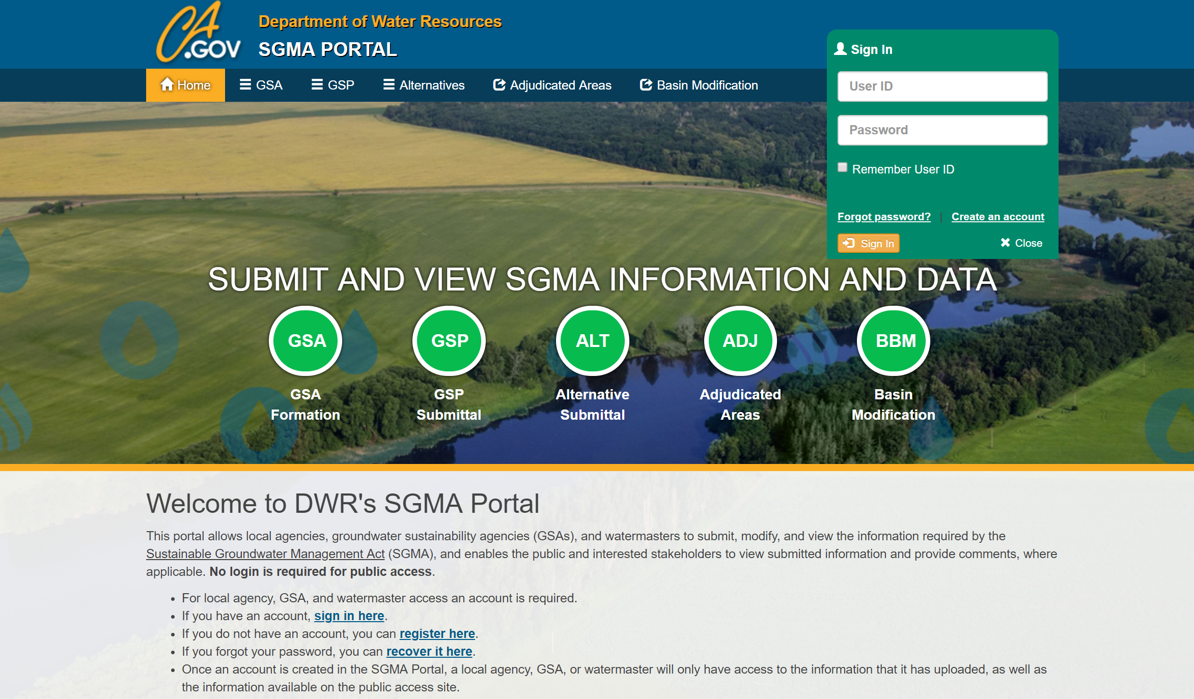
The ESJ GWA Filed its Initial Notification with DWR
Initial Notification to develop a GSP is required by SGMA legislation
Submitted online to the Department of Water Resources (DWR)
Describes how interested parties may participate in GSP development and implementation
Provides link to where information regarding GSP will be posted (website)
3

Slide 5
Coordination & Collaboration
4

Slide 6
Multiple Types and Levels of Stakeholders will be Involved
Public
GWA JPA members are stakeholders
Each member GSA is a stakeholder, and represents and includes multiple other stakeholders
Other organizations in the basin are stakeholders
Members of the public are stakeholders
Stakeholders
GSA
Staff
GWA JPA Members
5

Slide 7
Information Flow
Technical Team Develops Information
Plan Advisory Committee Provides Input
GWA JPA Provides Input
Stakeholders Provide Input
Members of the Public Provide Input
GWA JPA Provides Final Direction
Information Flow will Provide Opportunities for Broad Input Throughout GSP Development
6

Slide 8
Stakeholder Committee
GWA JPA Board
The Stakeholder Committee will Include Interested / Potentially Affected User Groups Required by SGMA and will Provide Process Feedback
Various groups will provide input to GSP elements
Plan Advisory Committee
Stakeholder Committee
General Public
Plan Advisory Committee
General Public
Stakeholder Committee
7

Slide 9
Stakeholder Committee
Structure
15 to 20 representatives of organizations the GSP will potentially affect
Individuals representing groundwater users outside the JPA and GSAs, such as:
Agricultural users
Environmental groups
Native American tribes
Disadvantaged communities
Federal and state land representatives
Local business interests
Role
Commit to charter that describes roles and responsibilities for committee participation
Participate in monthly meetings to review GSP components
Represent the interests of and report back to their organizations
Provide feedback and input through facilitated meeting discussions
8

Slide 10
Formation: Timeline and Approach
March
Develop application to invite stakeholders to serve on the committee
April
Distribute application to comprehensive list of diverse stakeholders as specified in the SGMA
Interested Parties complete and submit applications
Collaborate with staff to review applicants and form recommendation
May
Provide update to JPA
Develop and finalize charter for stakeholder committee
Notify applicants of the selected stakeholder committee
Committee members sign charter
Hold first meeting (target late May)
9

Slide 11
GWA Information and Resources
10

Slide 12
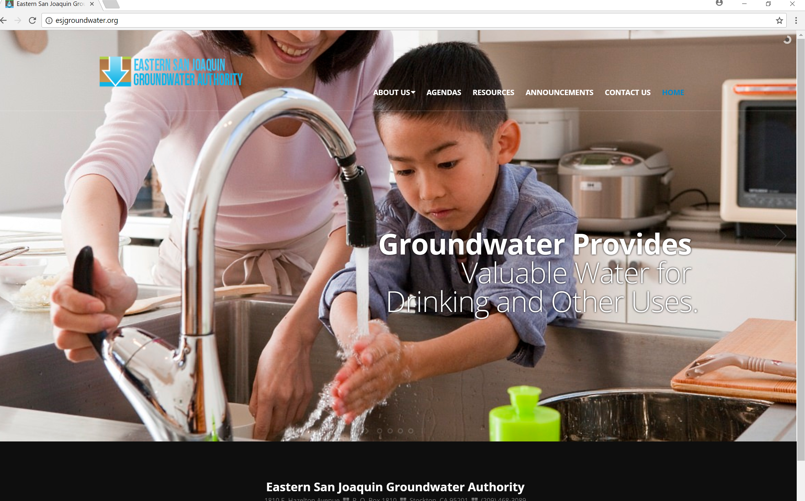
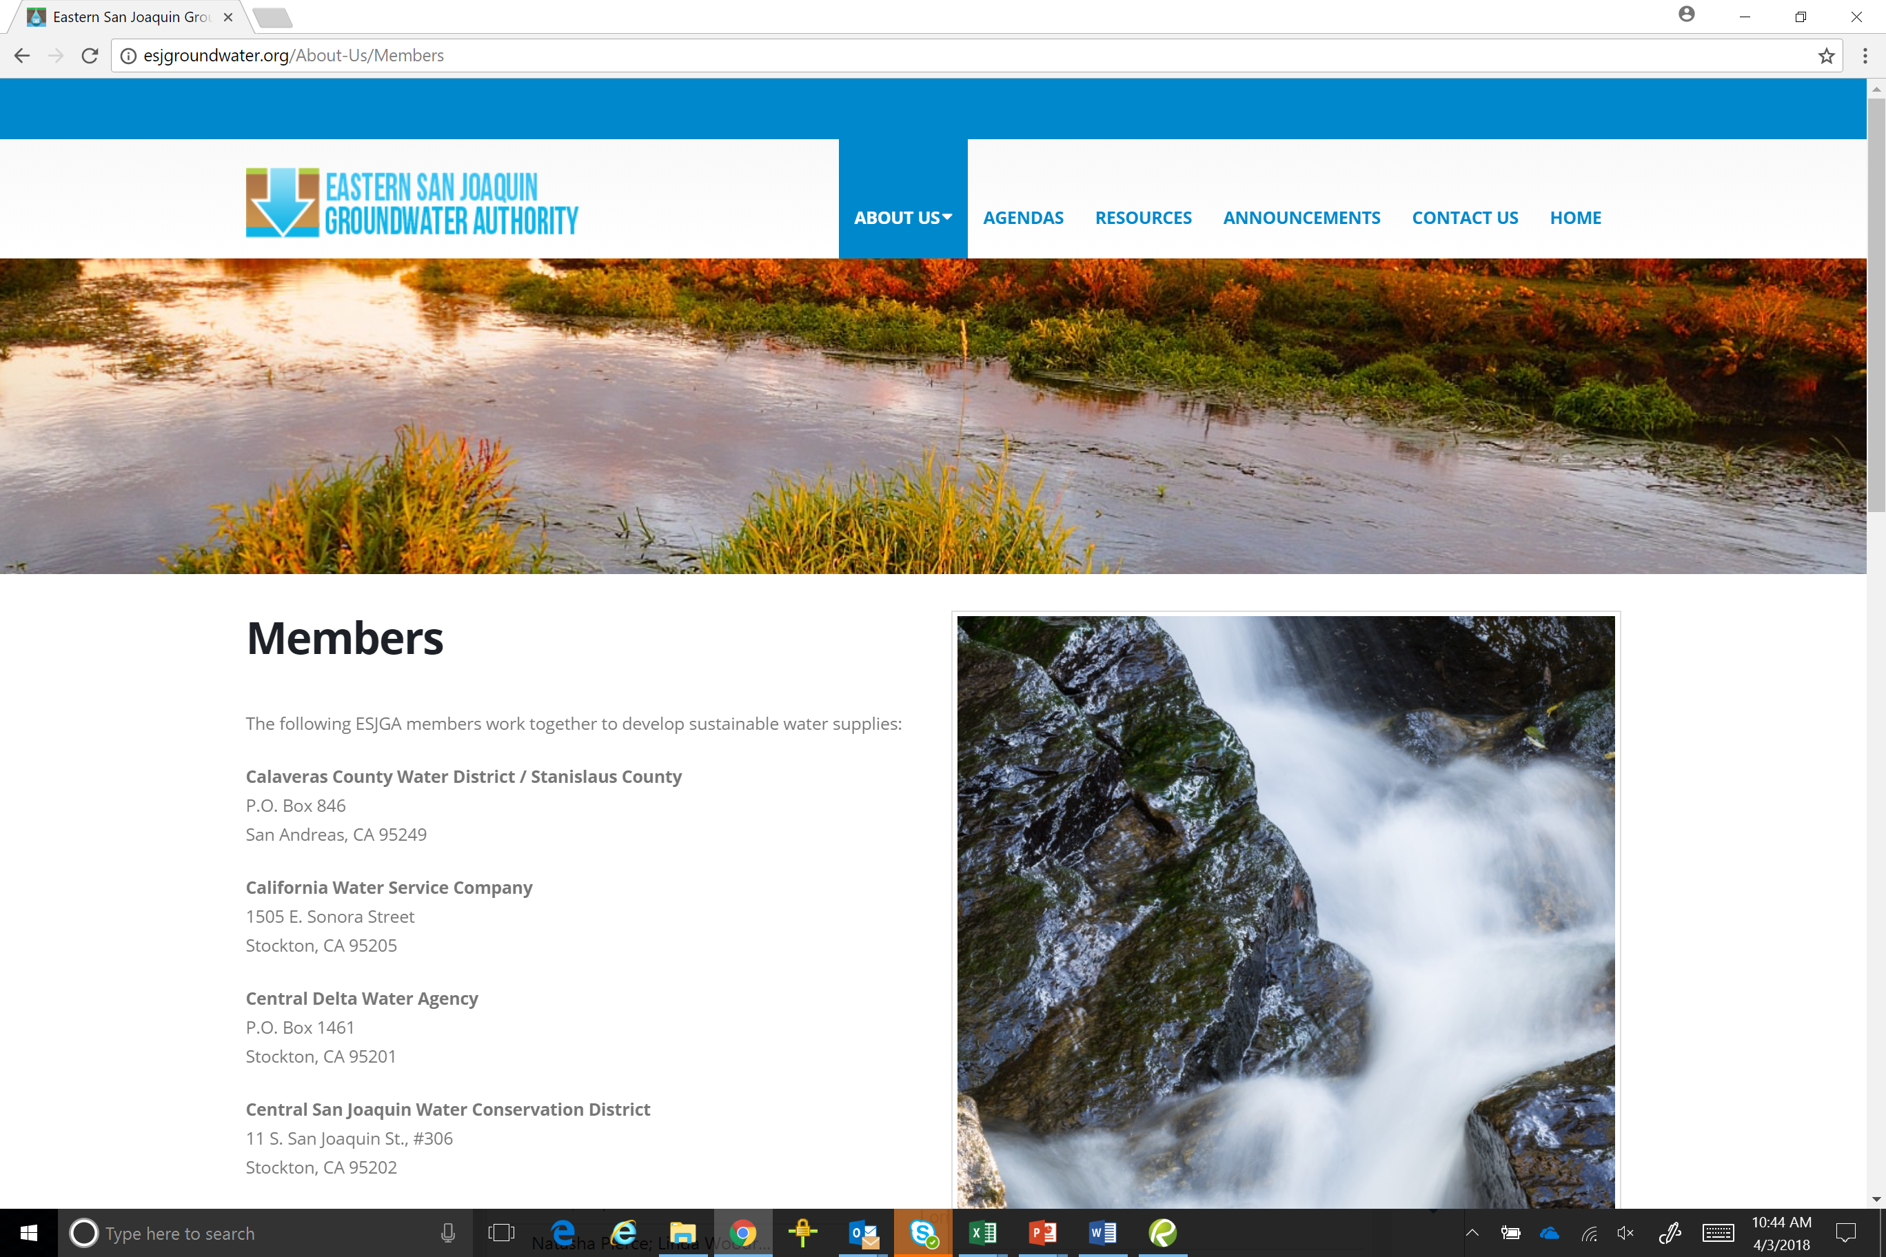
GWA Website is Being Updated!
11

Slide 13
Other Happenings
12

Slide 14
Technical Support Services (TSS)
ESJ GWA Pursuing Funding for Technical Support Services (TSS)
Goal: Provide education, data and tools to GSA
Applications for TSS in Spring 2018, evaluated on continuous basis
Critically overdrafted basins have priority for funding
Technical Support Services offered:
Field activities including groundwater level monitoring training, borehole video logging, geophysical logging, geologic logging, monitoring well installation
Modeling training and support
No match or fronting costs – DWR provides direct services
13

Slide 15
Next up in April…
Undesirable Results within the Six Sustainability Indicators
Chronic Lowering of Groundwater Levels
Reduction in Groundwater Storage
Seawater Intrusion
Degraded Water Quality
Land Subsidence
Depletion of Interconnected Surface Water
The significant and unreasonable occurrence of any of the six sustainability indicators constitutes an undesirable result.
14

