Slide 1

District Surface Water Use, Deep Well Production and SGMA Update
Eric Thorburn, P.E.
District Engineer/ Water Resources Manager
July 7, 2026

Slide 2
OID SURFACE WATER USE AND DEEP WELL PRODUCTION SUMMARY
Year | *Surface Water Diversions | October Surface Water Diversions | District Groundwater Pumping | Out of District Water Use
2024 | 234,924 | 21,859 | 1,309 | 7,872
2025 | 235,595 | 9,858 | 1,323 | 12,194
Avg. 2016-25 | 224,591 | 16, 778 | 2,013 | 5,229
Avg. 2021-25 | 239,802 | 16,771 | 1,612 | 6,518
*Calendar year surface water diversions.

Slide 6
18,298
12,590
10,112
6,634
3,577
2,451
2,874
2,488
2,311
1,686
1,482
1,579
1,331
1,309
1,323

Slide 7
0.9 AF/Ac
1.1 AF/Ac
1.1 AF/Ac
1.0 AF/Ac
1.0 AF/Ac
1.2 AF/Ac
0.6 AF/Ac
1.8 AF/Ac
1.5 AF/Ac
2.2 AF/Ac

Slide 8
May 2012
March 2016
84.3’ (-0.5’/yr)
81.0’
98.8’ (-3.6’/yr)
110.7’ (-1.2’/yr)
Overall: -1.4’/yr

Slide 9
71.4’ (-0.6’/yr)
81.5’ (-2.5’/yr)
67.2’
May 2012
March 2016
88.0’ (-0.65’/yr)
Overall: -1.0’/yr

Slide 10
84.1’ (-6.3’/yr)
121.0’ (-4.3’/yr)
48.0’
Overall: -3.5’/yr
59.1’ (-1.6’/yr)
126.9’ (-2.8’/yr)
112.8’
141.8’ (-1.5’/yr)
115.6’ (-0.4’/yr)
Overall: -1.4’/yr
188.9’
May 2012
March 2016
202.4’ (-2.7’/yr)

Slide 11
Sustainable GW Management Act (SGMA) Update
Eastern San Joaquin GW Subbasin
16 GSAs (707k ac) - north of the Stanislaus River
  GSP submitted Jan. 2020 (revised July 2022)
    Approved March 2023
  5-year Periodic Eval and Amended GSP submitted Jan. 2025
    DWR Request for Information Rec’d April 2026
      Response Due to DWR by October 1, 2026
    Impact Analysis & Well Mitigation Plan
    Commitment to Management Actions (Demand Reduction)
      GSA Allocations by Dec 2026
      DM Program Developed by GSAs by Dec 2027
      DM Implementation by GSAs by Dec 2028 (Where Needed)
  2025 WY Annual Report (7th) - Submitted by April 1st
    Continued water level decline in parts of the subbasin
  Projects
    OID 10-Yr OOD Water Sale Program – 4th Year (2026)
    10-year OID & SSJID transfer to SEWD
      Up to 20k AF in dry years, 10k AF in critically dry years (20k AF Anticipated to be Delivered in 2026)

Slide 12
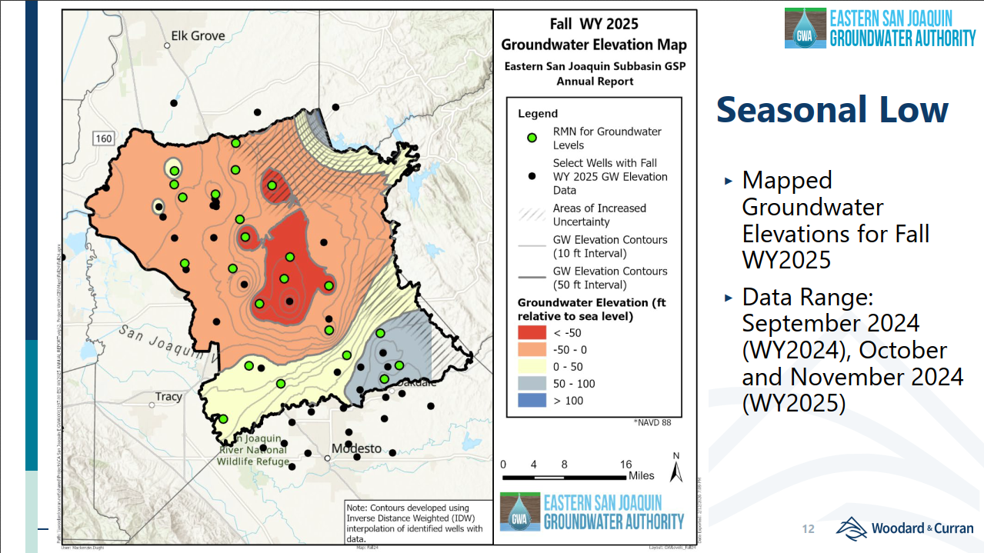

Slide 13
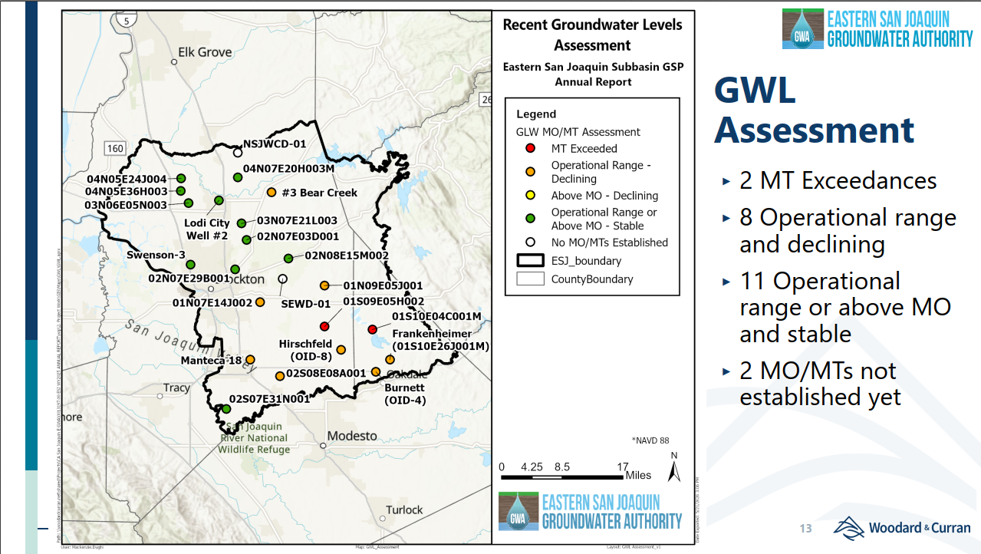

Slide 14
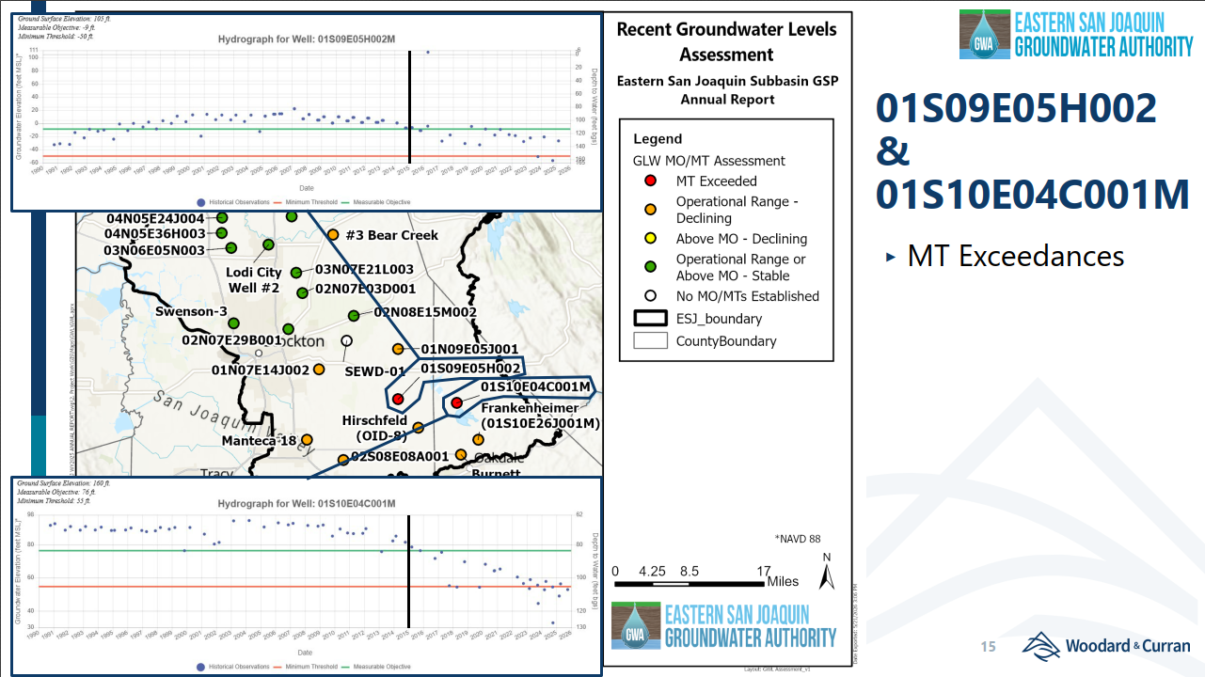

Slide 15
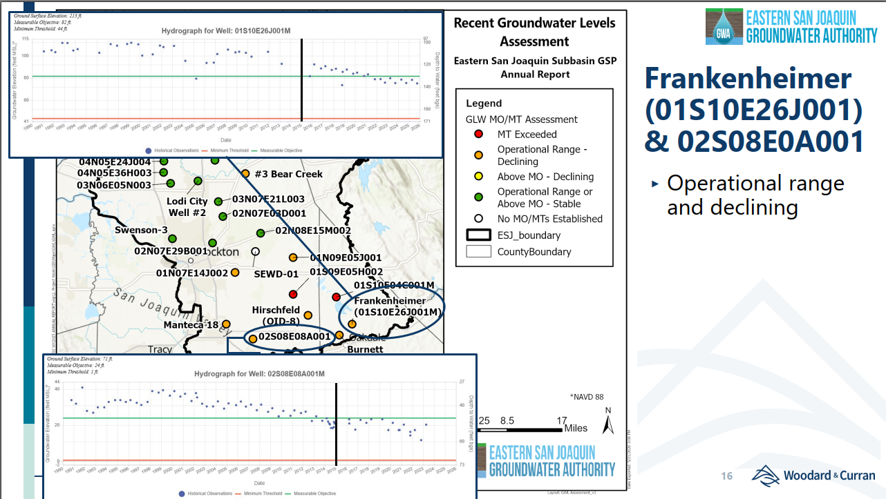

Slide 16
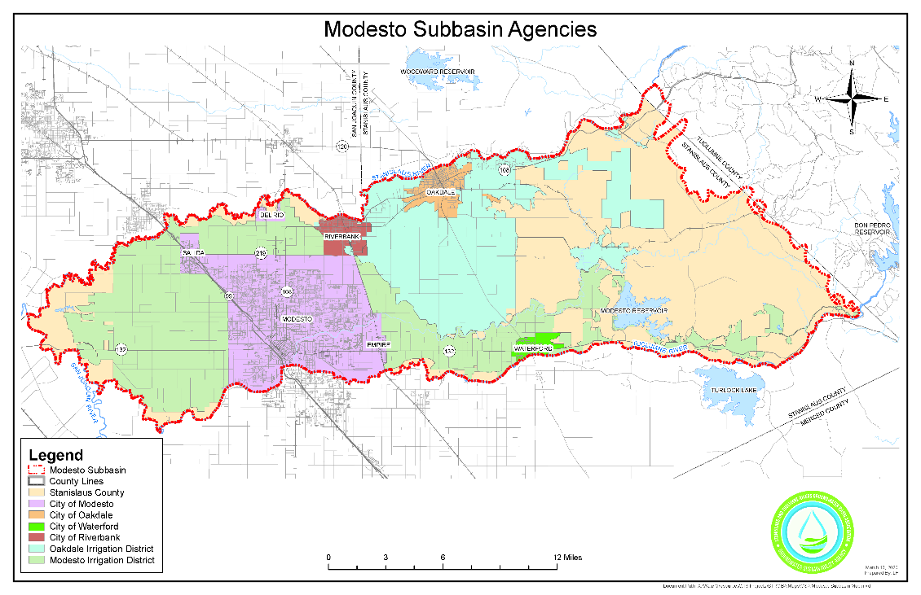
Sustainable GW Management Act (SGMA) Update
Modesto GW Subbasin
1 GSA (250k ac) - south of the Stanislaus River
  GSP submitted Jan. 2022 (revised July 2024)
    Approved March 2023
      Impact Analysis & Well Mitigation Plan Req’d
      Management Action Framework/Plan Req’d
  5-year Periodic Eval and Amended GSP due Jan. 2027
    Well Mitigation Plan Adopted Jan. 2026
    Groundwater Use Management Program Adopted Jan. 2026
        Management Action Plan to Meet Demand Reduction in the NDE due From Stan. Co by Nov. 2026
          Implementation of Demand Reduction in NDE Starting Jan. 2027
  2025 WY Annual Report (5th) - Submitted by April 1st
    Continued water level decline primarily in NDE
  Projects
    OID 10-Yr OOD Water Sale Program – 4th Year
    $14.4M SGM Implementation Grant – OID Paulsell Lat. Expansion (Phase 1 Constructed 2025 & 2026)

Slide 17
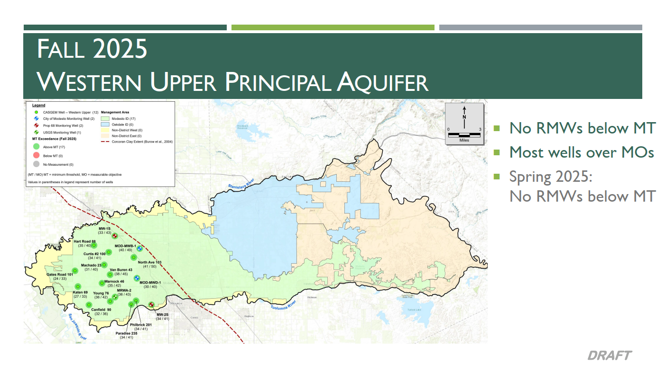

Slide 18
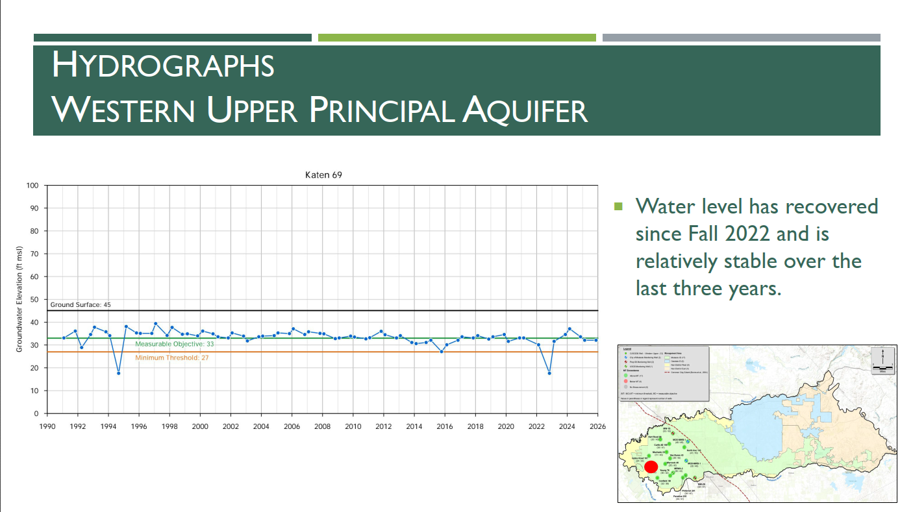

Slide 19
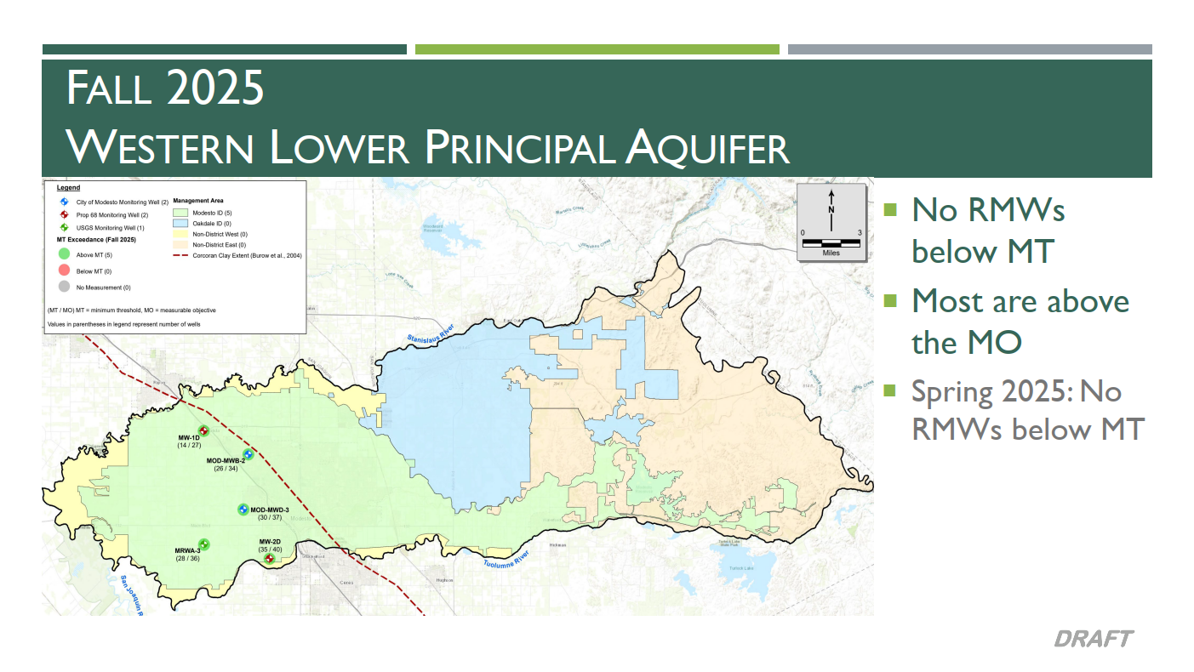

Slide 20
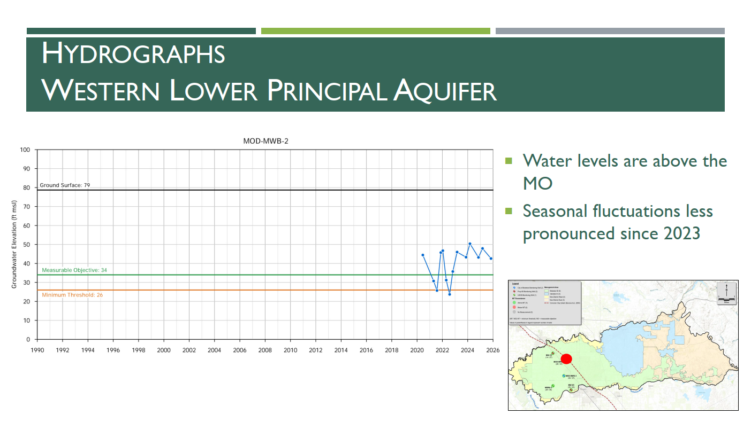

Slide 21
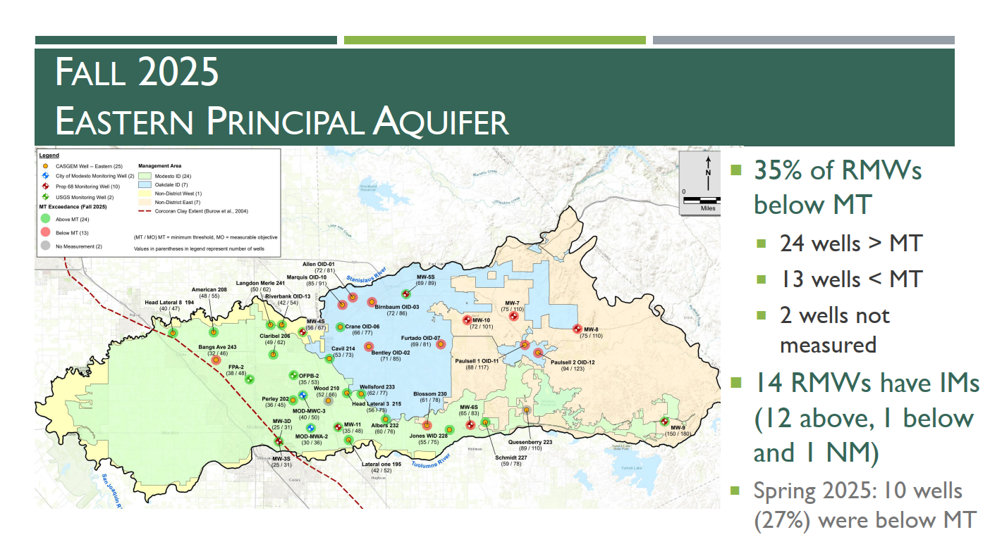

Slide 22
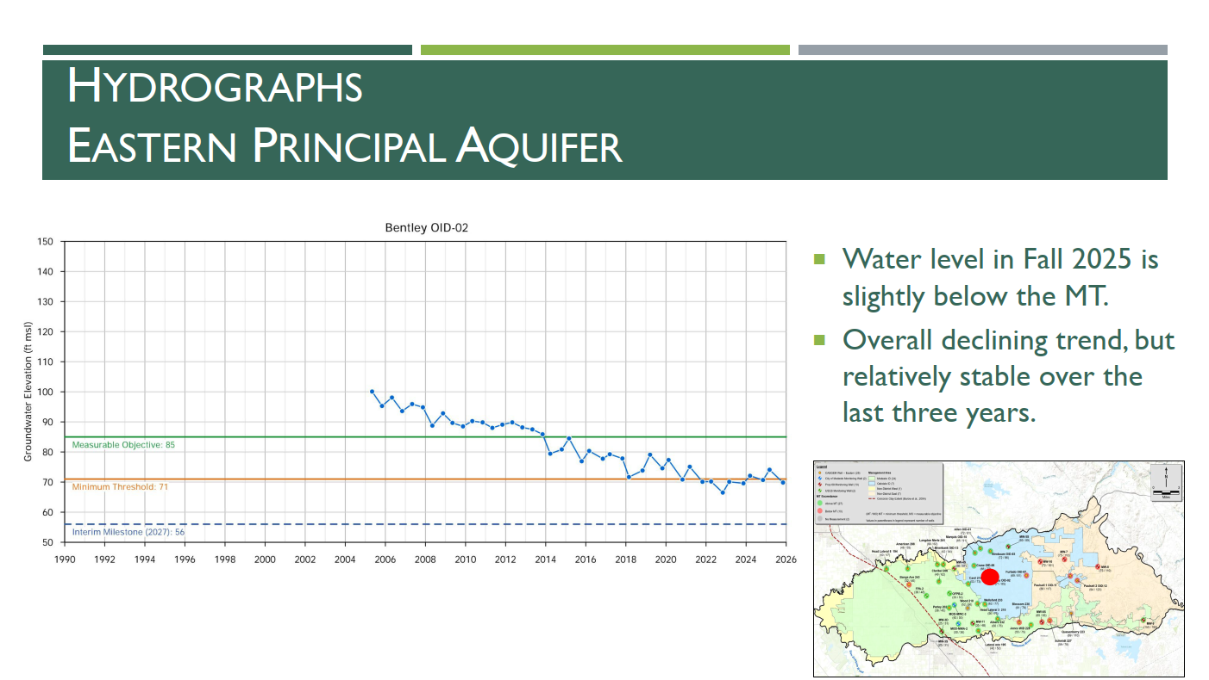

Slide 23
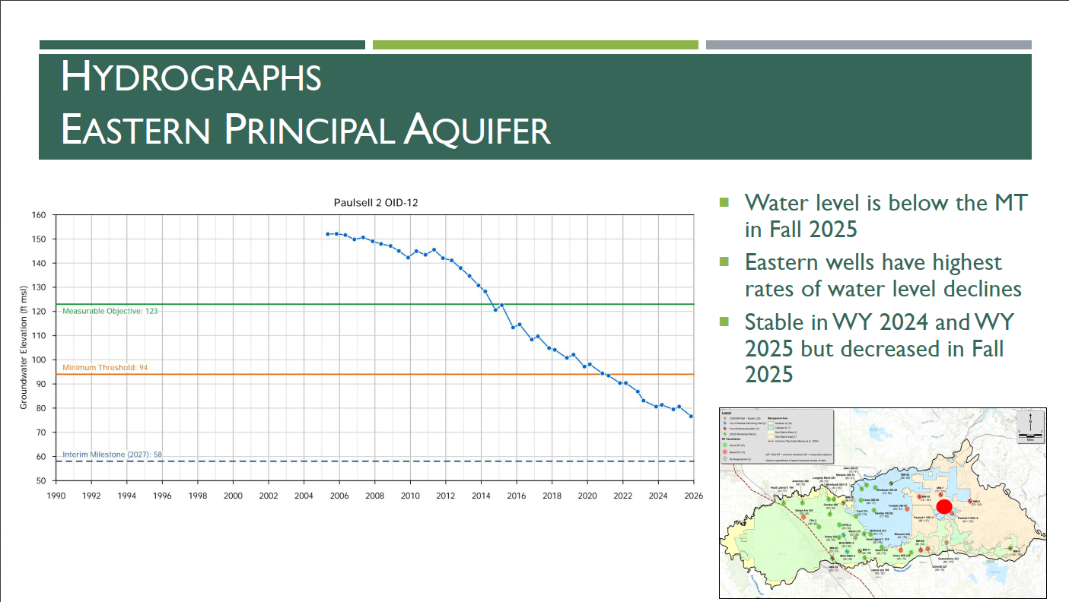

Slide 24
