Slide 1
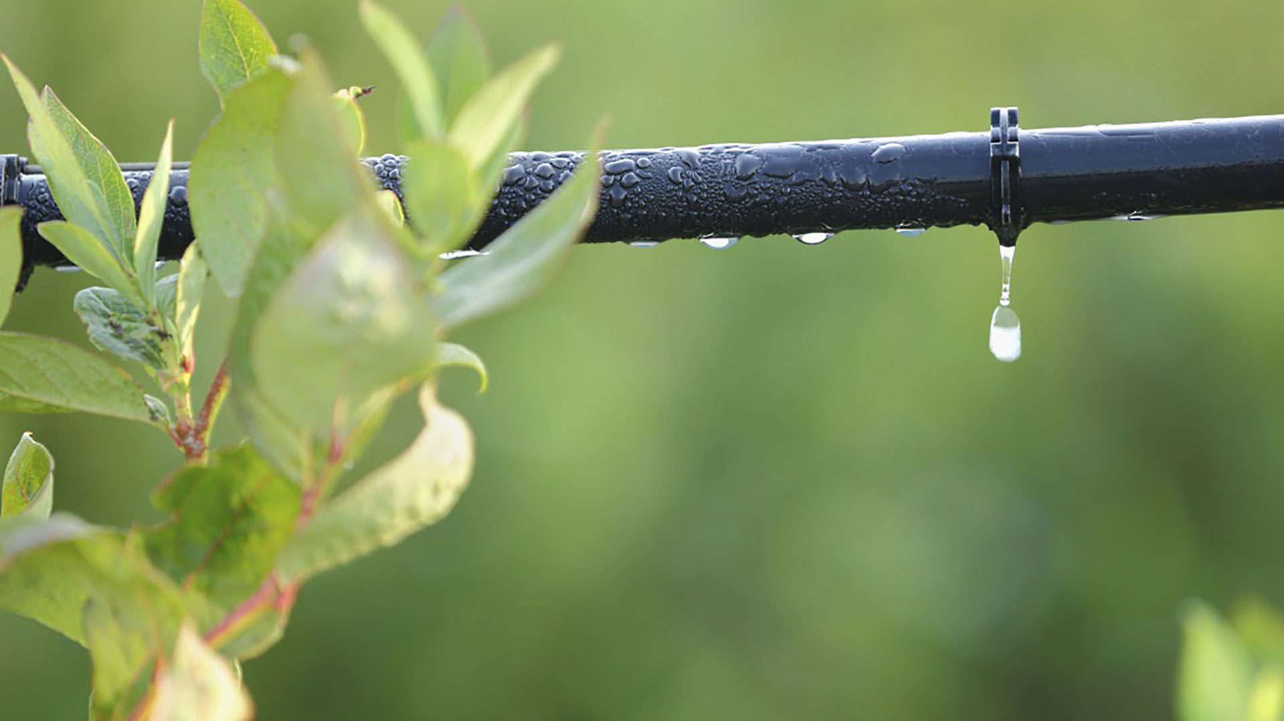
Materials for GSA Outreach October 2019

Slide 2
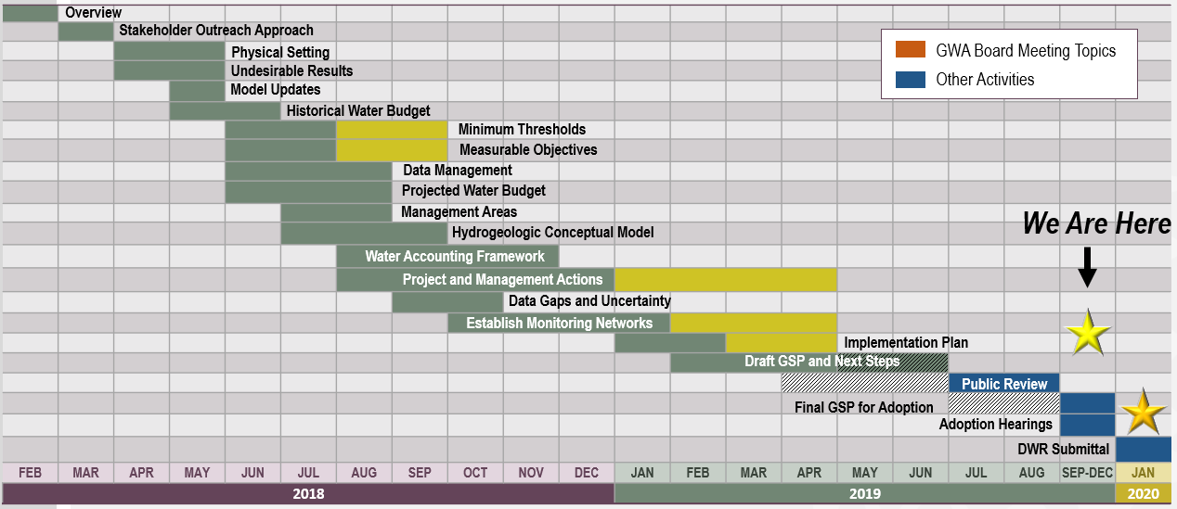
GSP Topics & Project Schedule
GSP Topics
GSP Finalization Elements
2

Slide 3
Announcements & Reminders
Changes to Regular Meeting Schedule:
The October 9 meeting has been rescheduled to Thursday, October 17
Early Advisory Committee Meeting (8:30 - 9:30)
Extended GWA Board Meeting (10:00 – 1:00, with break for lunch)
New Location (this meeting only):
Delta Water Supply Treatment Plant, located at 11373 North Lower Sacramento Rd., Lodi, CA
3

Slide 4
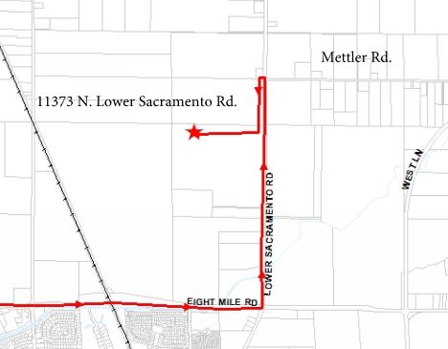
Announcements & Reminders
New Location (this meeting only):
Delta Water Supply Treatment Plant, located at 11373 North Lower Sacramento Rd., Lodi, CA
4

Slide 5
Announcements & Reminders
Two Ad-Hoc Committees have been formed by the GWA Board:
GSP Implementation Ad-Hoc Committee – Meets approximately weekly to form recommendations on implementation next steps including the Prop. 68 grant application.
GSP Public Comment Review Ad-Hoc Committee – Will meet for a total of 3 Workshops to review and craft response recommendations on public comments received on the Draft GSP. Recommendations will be reported to the Board on October 17.
5

Slide 6
Outreach & Groundwater Sustainability Workgroup Update

Slide 7
Groundwater Sustainability Workgroup Update
The final Workgroup meeting was held on September 11 at the San Joaquin County Public Works Department Building.
Notes from Workgroup meetings are available on the website, www.esjgroundwater.org (under ‘Agendas’ tab)
7

Slide 8
Prop. 68 Grant Application Timeline

Slide 9
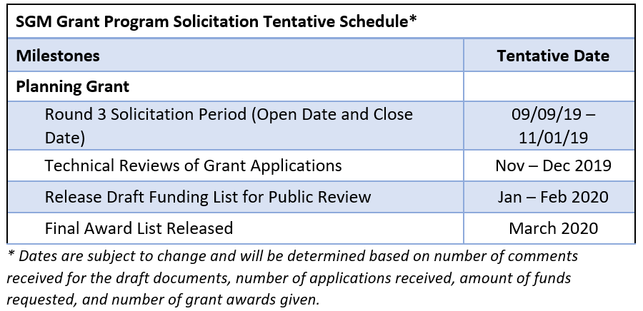
Prop. 68 Grant Application Schedule
Background:
The GWA Board is pursuing funding under Proposition 68 Round 3.
The solicitation period closes Nov. 1, 2019.
The Subbasin is eligible for up to $500,000. in funding under this round.
9

Slide 10
Draft GSP Comment Incorporation Process

Slide 11
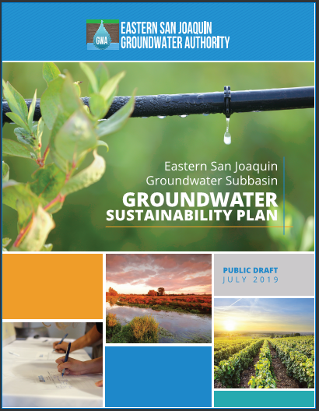
Release of Public Draft
Published on Website July 10
Hard copies posted in libraries and at GSA main offices
Notices and press releases in English and Spanish
45-day public comment period closed August 25
Lodi Public Library
Cesar Chavez Central Library
Margaret Troke Library
Maya Angelou Library
Fair Oaks Branch Library
Weston Ranch Library
11

Slide 12
18 Public Comment Letters Received
NGOs
The Nature Conservancy
Restore the Delta
Sierra Club, Delta-Sierra Group
California Poultry Federation
California Sportfishing Protection Alliance
Joint comments (includes The Nature Conservancy, Audubon California, Clean Water Action, Clean Water Fund, American Rivers, Union of Concerned Scientists)
Neighboring Subbasins
Cosumnes Subbasin
Tracy Subbasin
The Freshwater Trust (on behalf of North Delta GSA)
GSAs
North San Joaquin WCD
South San Joaquin GSA
Stockton East Water District
State and Federal Agencies
California Department of Fish and Wildlife, North Central Region
Others
Jane Wagner-Tyack (Consultant)
EBMUD
Larry Walker Associates
The Wine Group
Terra Land Group, LLC
12

Slide 13
Approach to Responding to Comments
Comment Categories | Response Approach | Next Step for Addressing Responses
Minor Corrections/Clarifications | Direct edits to text in GSP | Board direction given to approve consultant make changes to text in GSP
Substantive comments on Draft GSP | Categorized by topic, master response to be developed, revisions to GSP based on direction from GSAs | Schedule 2-3 Ad-hoc Committee Workshops before October Board meeting
Comments on future considerations for GSP Implementation | Categorized and noted for GWA Board consideration and future AC meeting discussion. | No immediate action needed – items noted for future follow up
13

Slide 14
Adoption Timeline & Next Steps
4

Slide 15
Timeline for GSP Adoption
Public Draft comment period July 10 – Aug. 25
NOI to adopt GSP distributed – Aug. 16
Final Draft distributed – Nov. 5
JPA recommendation to adopt – Nov. 13
Individual GSAs adopt Final Draft GSP – Nov. 14 – Jan. 1
JPA action to accept Plan – Jan. 8
GSP submittal deadline – Jan. 31, 2020
15

Slide 16
October Agenda Items
4

Slide 17
October Agenda Items
Response to Public Comments (Ad-hoc Recommendation)
Ad-hoc Implementation Recommendations
Adoption Next Steps
17

