Slide 1
Materials for GSA Outreach March 2019

Slide 2
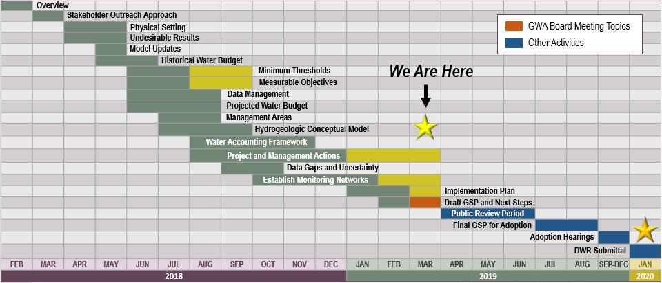
GSP Topics & Project Schedule
GSP Topics
GSP Finalization Elements
2

Slide 3
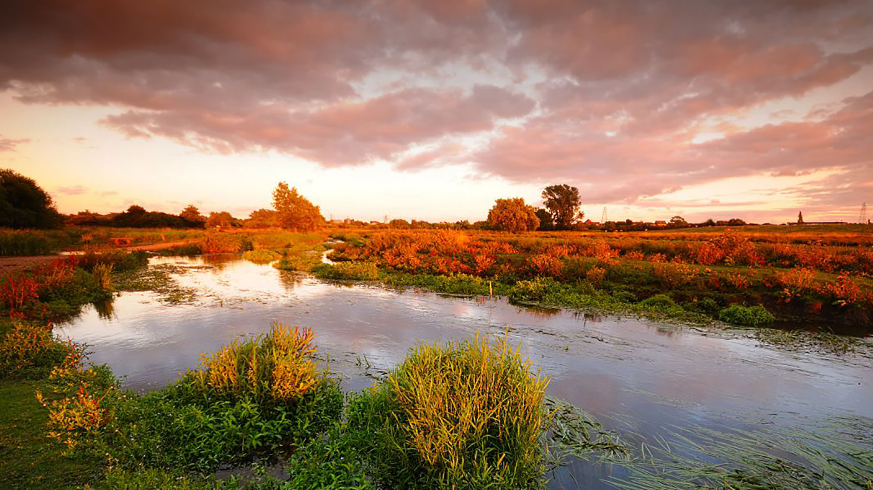
Outreach Update

Slide 4
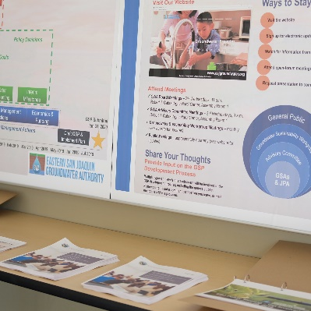
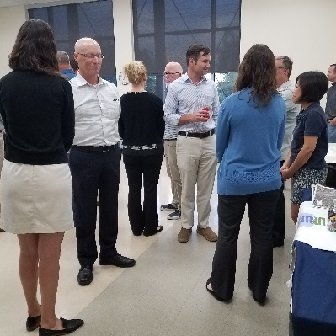
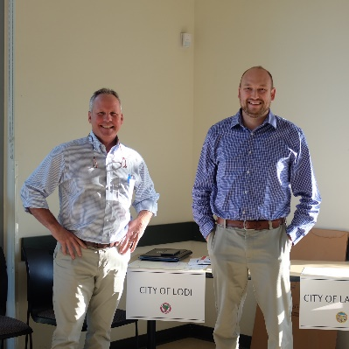
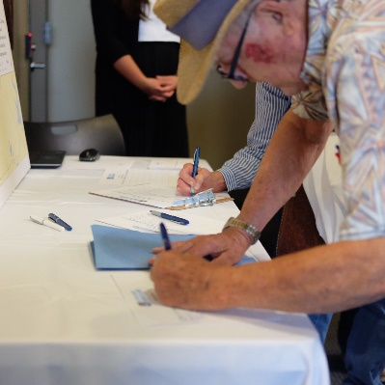
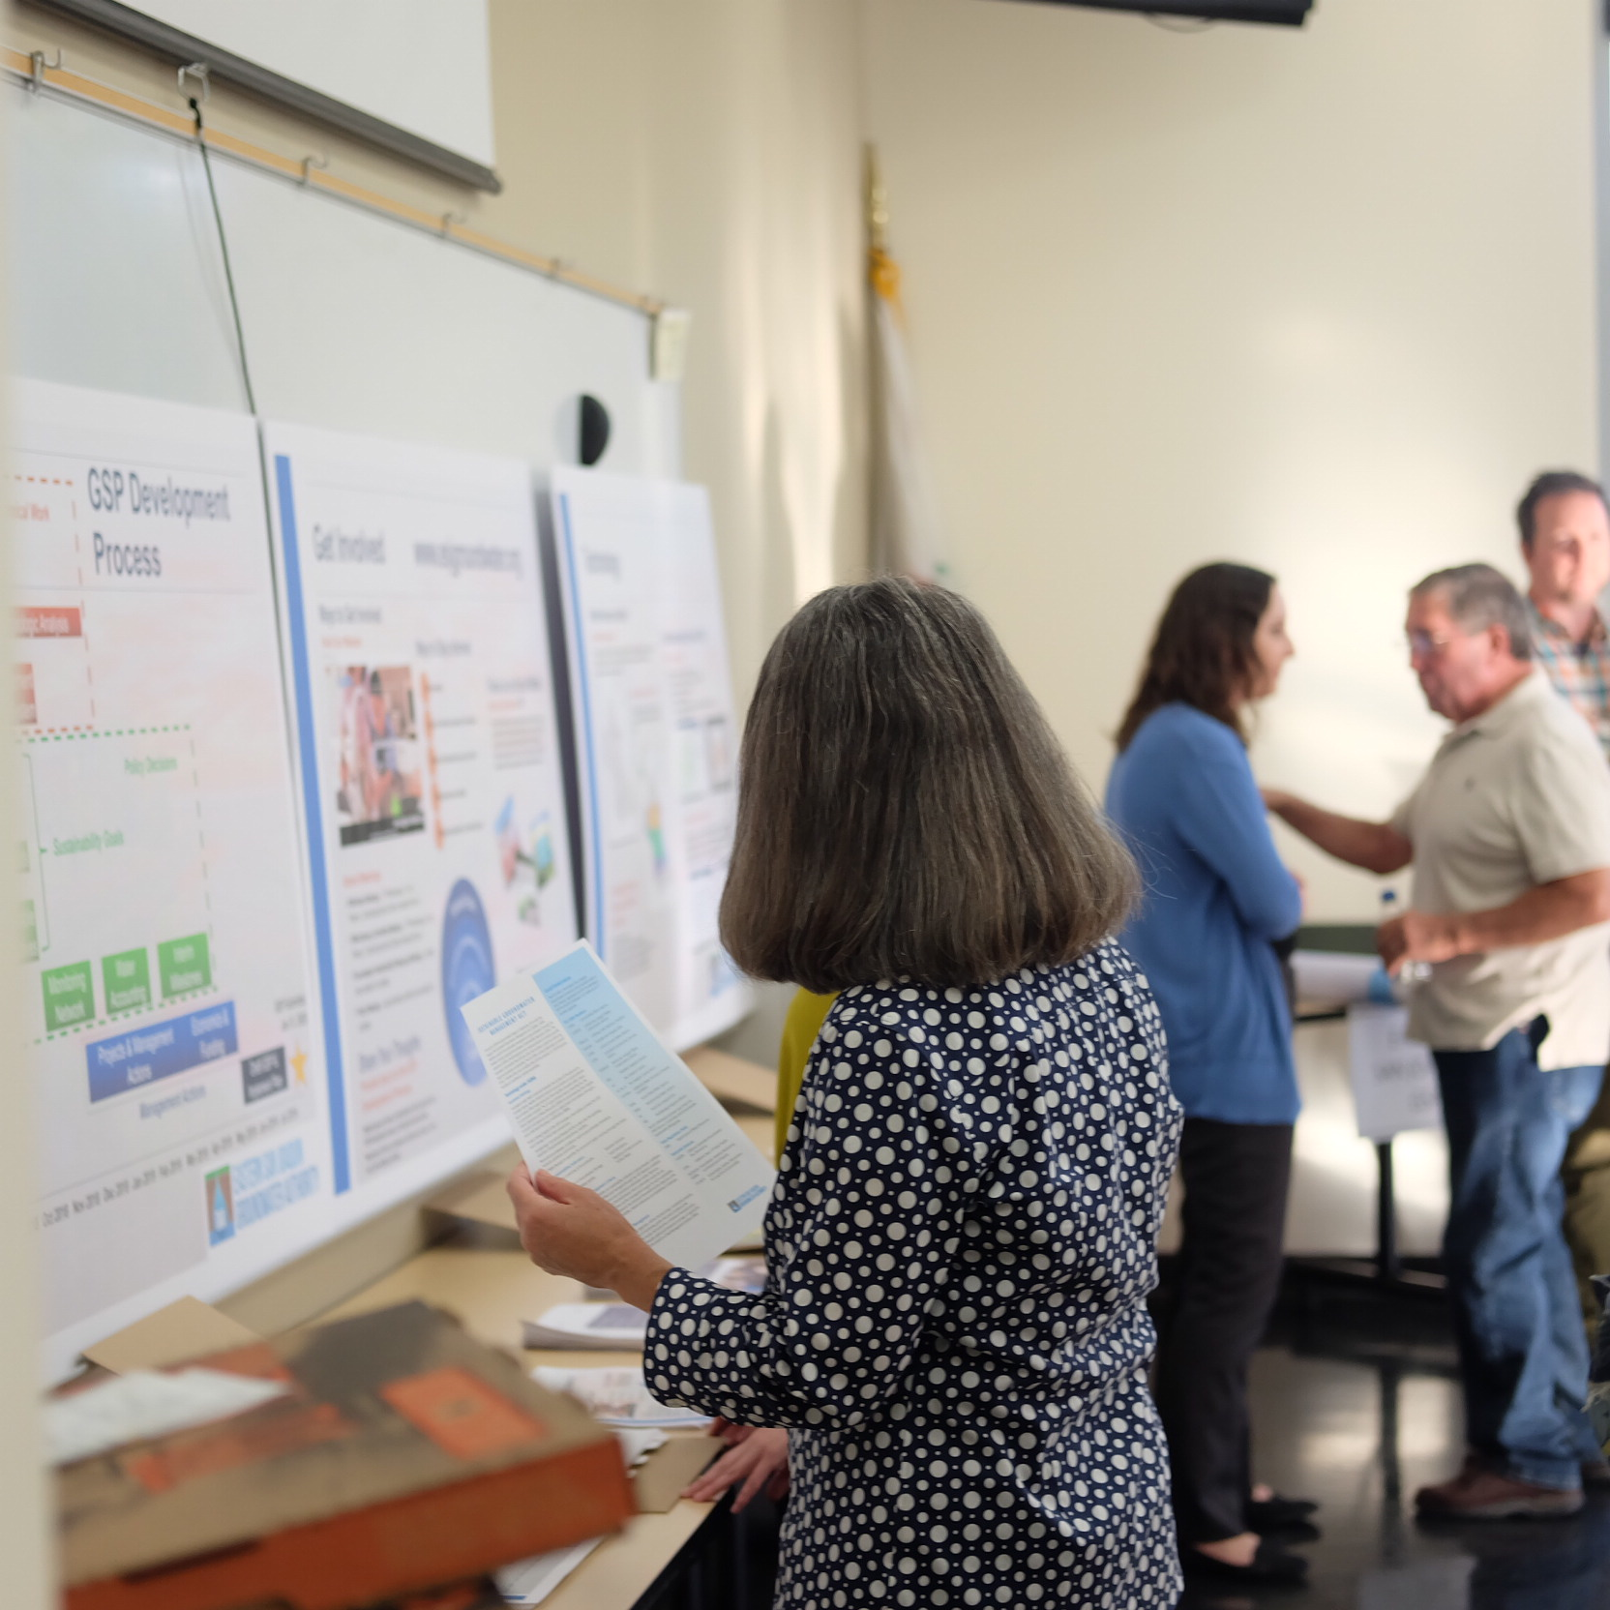
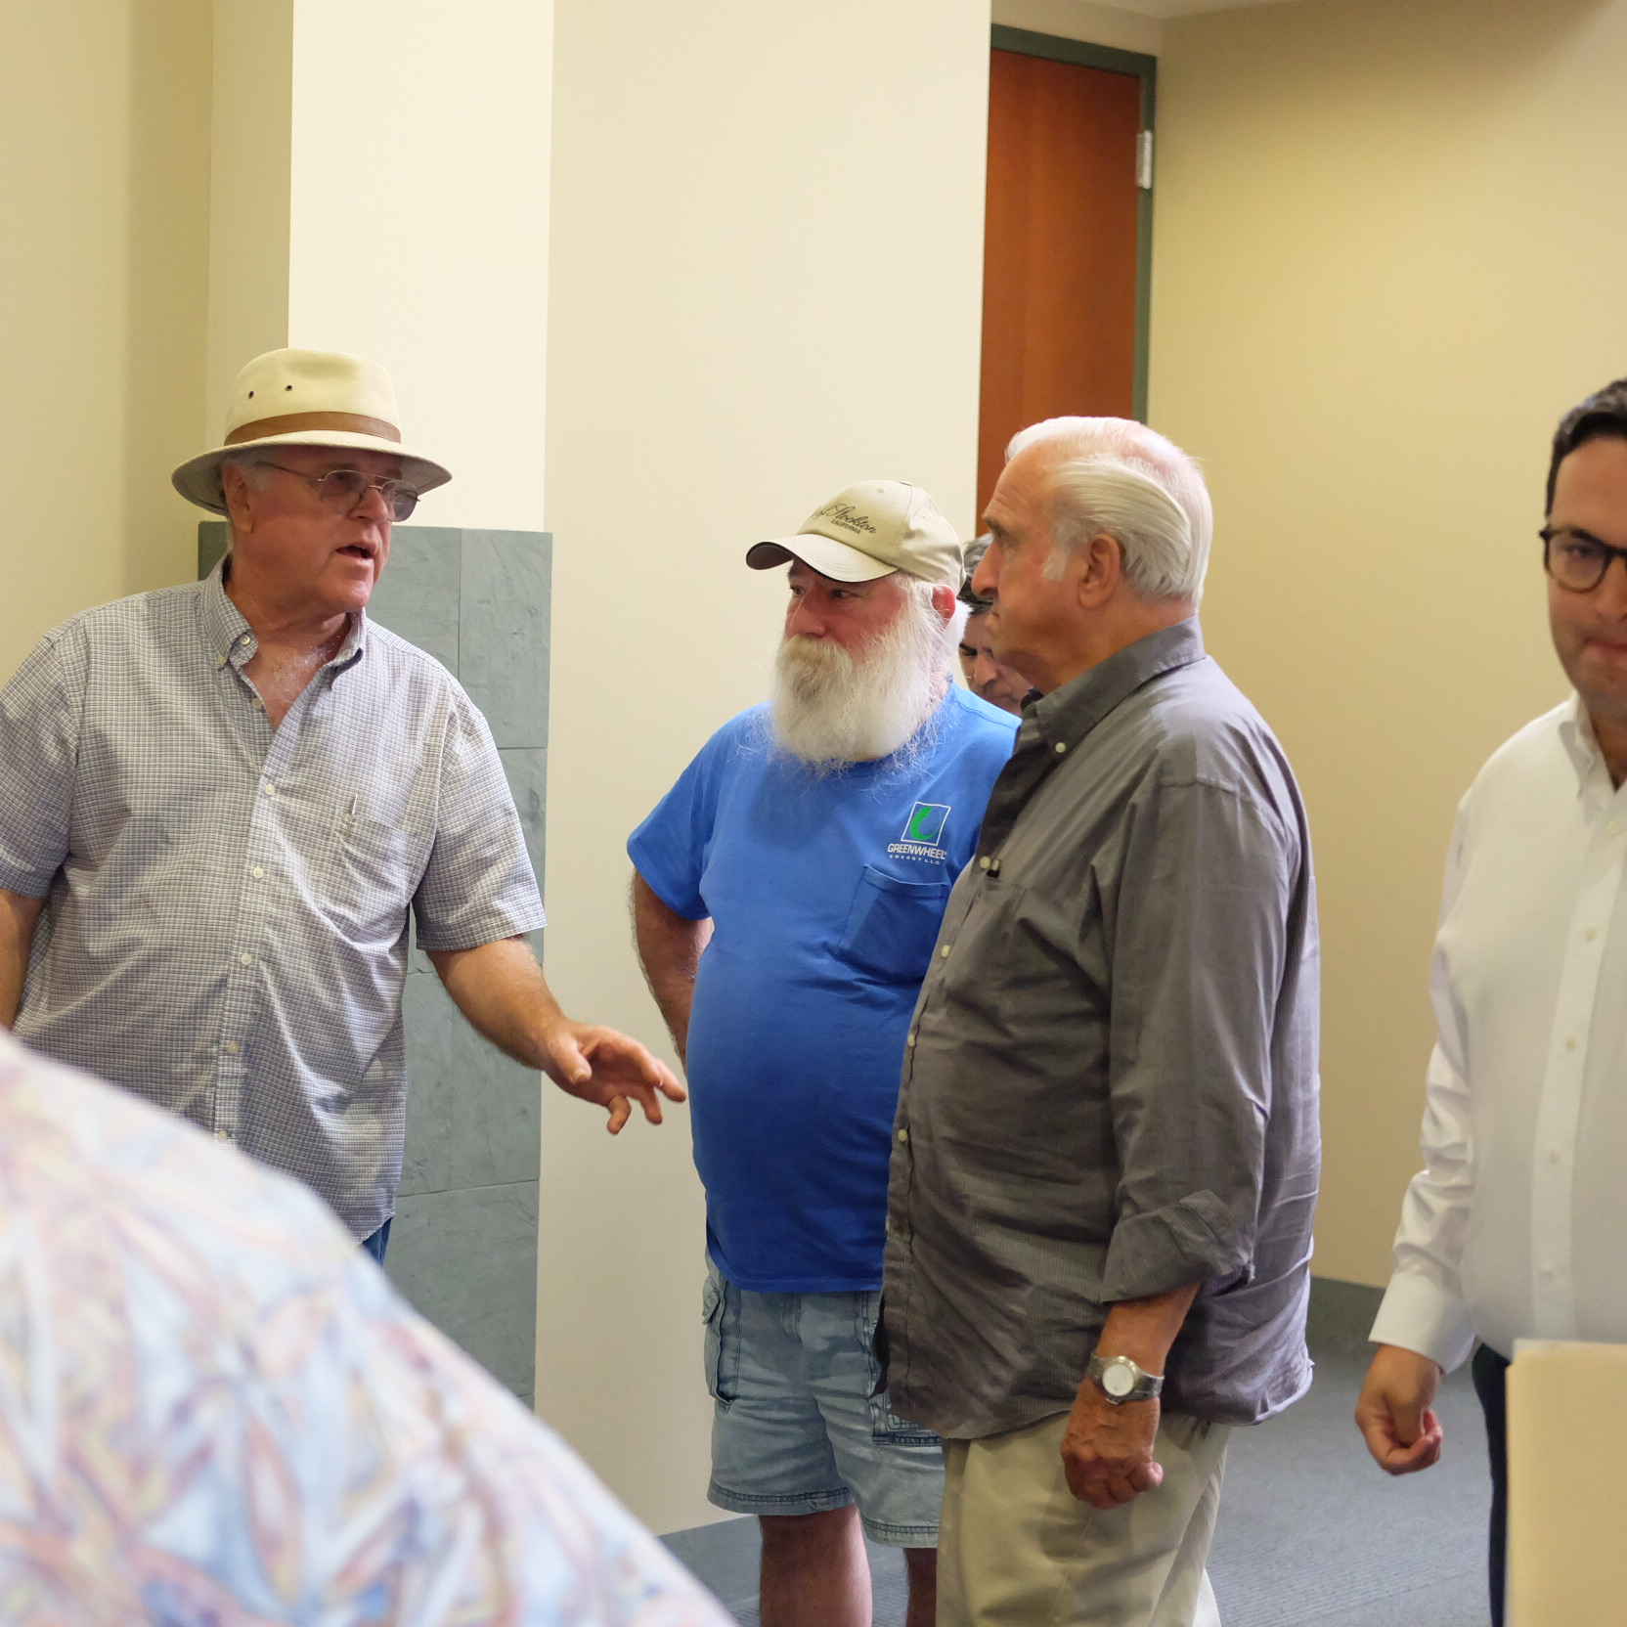
Informational Meeting Recap
Thank you GSAs for sending representatives!
Open House materials are posted to the website
Feedback on the event – what would you like to see done differently next time?
4

Slide 5
Groundwater Sustainability Workgroup Update
11 Workgroup members and 3 members of the public attended the Groundwater Sustainability Workgroup meeting held on February 13th
The next Workgroup meeting will be held on March 13th at 4:00pm at the San Joaquin County Public Works Department
Notes from the Workgroup meetings are available on the website, esjgroundwater.org (under ‘Agendas’ tab)
5

Slide 6
Tracking GSA Outreach Efforts
GSAs have been asked to fill out a simple survey each month to indicate the outreach activities planned for the coming month with approximate data on implementation
Logged outreach activities are distributed prior to the Board meetings
6

Slide 7
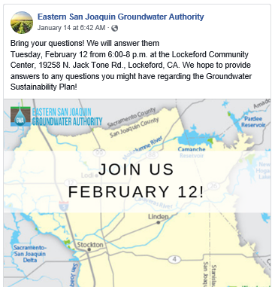
Regular Updates are Posted to Facebook
The ESJ GWA Facebook page provides updates on GSP development and upcoming events
You can like the page, share posts, or tag the page in your own posts
www.facebook.com/ESJGroundwaterAuthority
7

Slide 8
Overview of State Backstop
4

Slide 9
Reminder: State Intervention
There are stipulations in the regulation if GSAs cannot come to agreement
If deadline is missed or if DWR determines a plan is not adequate or progress toward sustainability is not occurring, the State Water Resources Control Board (SWRCB) can designate basins as “probationary” and directly manage groundwater extractions. If this occurs, the State can control extractions through pumping allocations (metering and monthly reporting required)
9

Slide 10
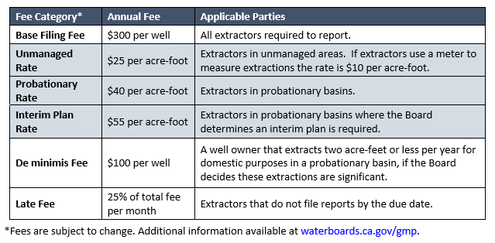
Potential Fees for Under State Intervention – State Backstop

Slide 11
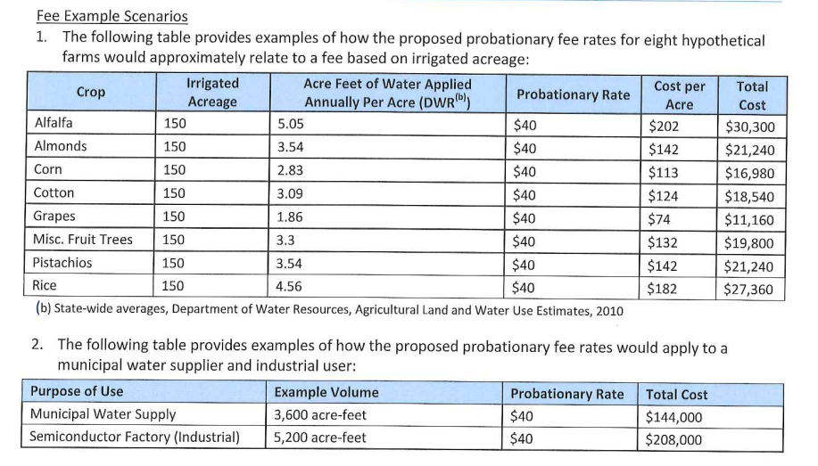
Potential Fees for Under State Intervention – State Backstop

Slide 12
Pathway Toward GSP Preparation
4

Slide 13
Pathway to GSP Preparation
Prepare GSA-level water budgets
Meeting with GSAs Feb/Mar to review
Determine preferred approach to meeting needs by GSA (local projects, multiple GSAs working together, regional projects, etc)
Determine appropriate funding / financing approach
GSA-level, multiple GSAs jointly funding, regional funding
Identify additional regional projects necessary for subbasin-level SGMA requirements
13

Slide 14
A Hybrid Solution
Basin-wide and GSA-scale projects will be discussed
Potential for enhanced flexibility for GSAs
Potential for a diversity of funding mechanisms
Understanding GSA-level water budgets will help GSAs determine if GSA-level projects are needed or desired
14

Slide 15
Financing Strategies
4

Slide 16
ESJ Specific Considerations
Basin-scale, GSA-scale, or hybrid approach
Which GSAs will have implementation projects?
Cost allocation for administrative costs
Monitoring and reporting
Data collection and analysis
Project implementation
Administrative actions
5-year update
DMS updates
Public outreach
Website maintenance
Legal support
Grant writing
16

Slide 17
Financing Strategies
Four primary ways of raising revenue
Usage Rates / Charges
Property / Sales Taxes
Targeted Taxes
Benefits allocation and billing of GSAs
Most multi-party organizations use a “blended” approach
17

Slide 18
Grant Agreement Update
4

Slide 19
Grant Agreement Update
The DWR 2017 Proposition 1 Sustainable Groundwater Planning (SGWP) Grant has been approved and is in the process of being amended to incorporate updates to the basin map and budget table
Total grant amount: $1,500,000
Invoices can be submitted to DWR once amendment is finalized
19

Slide 20
Changes to GSAs
4

Slide 21
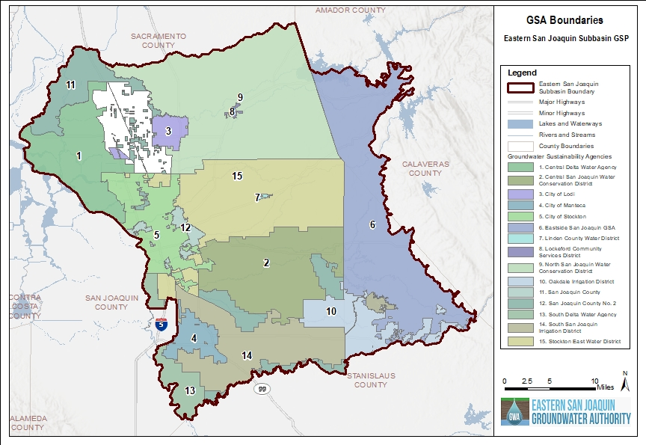
Changes to GSAs
City of Lathrop Basin Boundary Modification
Woodbridge Irrigation District GSA withdrawal
21

