Slide 1
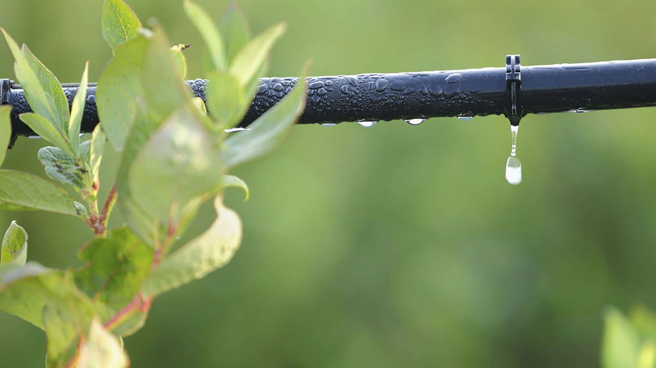
Materials for GSA Outreach November 2019

Slide 2
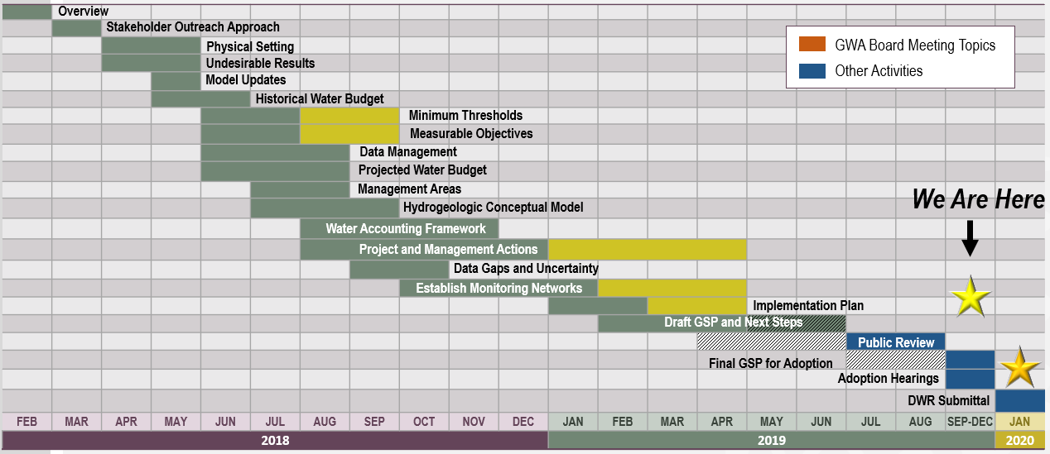
GSP Topics & Project Schedule
GSP Topics
GSP Finalization Elements
2

Slide 3
Announcements & Reminders
The Final GSP will be posted to www.esjgroundwater.org on November 5.
November 13 GWA Board and AC meetings will be held at the Robert J. Cabral Agricultural Center, back to the regular location and time.
3

Slide 4
Outreach & Groundwater Sustainability Workgroup Update

Slide 5
Groundwater Sustainability Workgroup Update
The final Workgroup meeting was held on September 11 at the San Joaquin County Public Works Department Building.
Notes from Workgroup meetings are available on the website, www.esjgroundwater.org (under ‘Agendas’ tab)
5

Slide 6
Prop. 68 Grant Application Timeline

Slide 7
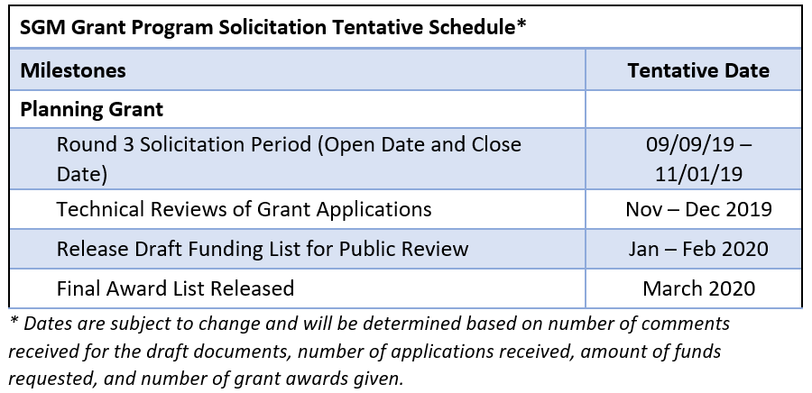
Prop. 68 Grant Application Schedule
The GWA Board is pursuing funding under Proposition 68 Round 3.
The solicitation period was extended from Nov. 1 to Nov. 15, 2019.
The letter of support template is posted to www.esjgroundwater.org. We are requesting letters from DACs, neighboring subbasins, and GSAs.
The Subbasin is eligible for up to $500,000. in funding under this round.
11/15/19
7

Slide 8
Adoption Timeline & Next Steps
4

Slide 9
Timeline for GSP Adoption
Public Draft comment period July 10 – Aug. 25
NOI to adopt GSP distributed – Aug. 16
Final Draft distributed – Nov. 5
JPA recommendation to adopt – Nov. 13
Individual GSAs adopt Final Draft GSP – Nov. 14 – Jan. 1
JPA action to accept Plan – Jan. 8
GSP submittal deadline – Jan. 31, 2020
9

Slide 10
GSA Adoption
GSA Public Hearing dates to consider GSP adoption are posted to www.esjgroundwater.org on the homepage.
A draft resolution template for GSP adoption is available for GSA use. It is posted to www.esjgroundwater.org, under the Agendas tab.
10

Slide 11
November Agenda Items
4

Slide 12
November Agenda Items
Ad-hoc Implementation Recommendations
Adoption Next Steps
12

