Slide 1
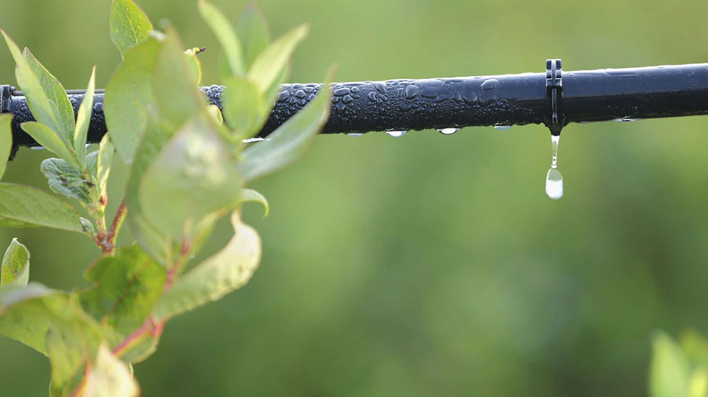
Materials for GSA Outreach August 2019

Slide 2
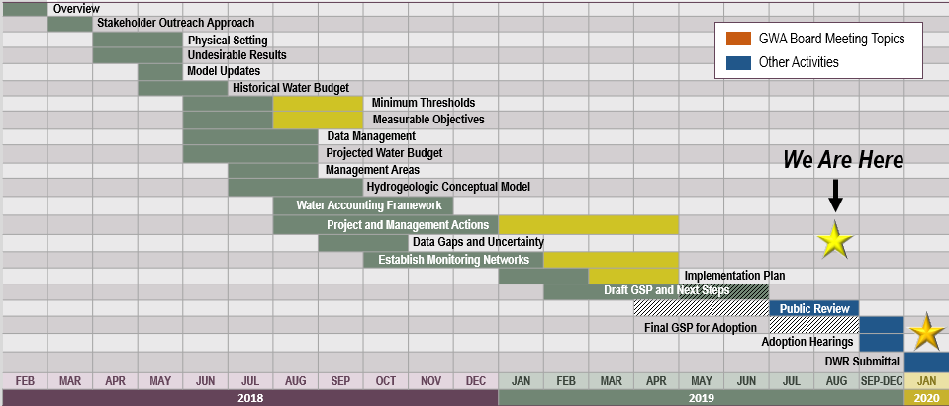
GSP Topics & Project Schedule
GSP Topics
GSP Finalization Elements
2

Slide 3
Draft GSP Public Review Period & Process for Adopting
4

Slide 4
The Draft GSP Public Comment Period is Underway
The full Draft GSP is available for public comment (July 10 – Aug 25).
The Draft Plan is posted to the website homepage: www.esjgroundwater.org
Comments are due Aug 25, 2019 to info@esjgroundwater.org
4

Slide 5
Draft GSP – Chapter Overview
Agency Information, Plan Area, and Communication
Basin Setting
Hydrogeologic Conceptual Model
Current & Historical Conditions
Water Budget
Sustainable Management Criteria
Monitoring Networks
Data Management System
Projects & Management Actions
Plan Implementation
5

Slide 6
SGMA Outreach Meetings
4

Slide 7
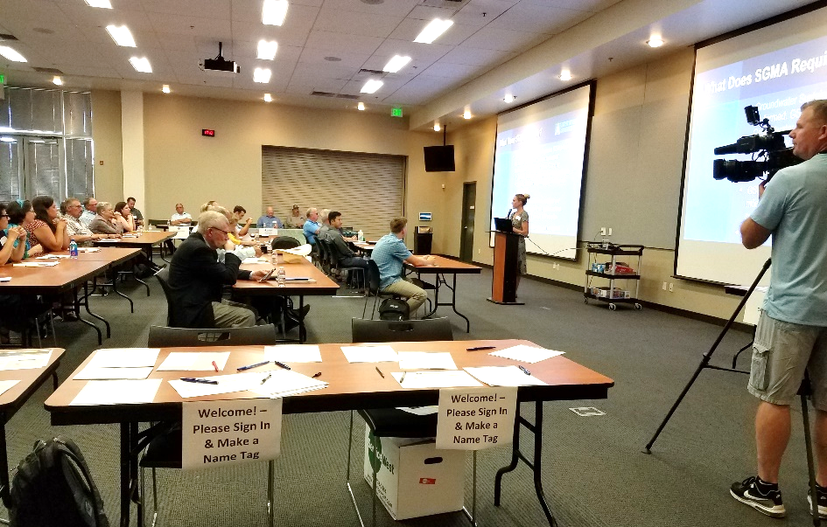
Fourth Informational Meeting (Recap)
The fourth Informational meeting was held on July 18 in Stockton.
38 attendees
Great showing by GSAs
Open house style beginning with a brief presentation
Handouts to be posted to website
7

Slide 8
Additional Upcoming SGMA Outreach Opportunities
French Community Meeting Wednesday, August 7 (5:00 – 7:00 PM) Robert J Cabral Agricultural Center (Mokelumne Room) 2101 E Earhart Ave., Stockton
Thornton Community Meeting Thursday, August 8 (5:00 – 7:00 PM) Thornton Community Center 26675 N Sacramento Blvd, Thornton
Mokelume River Association Meeting Friday, August 16 (10:00 AM) Hotel Leger 8304 Main St., Mokelumne Hill
Meeting details are posted to www.esjgroundwater.org
8

Slide 9
Outreach & Groundwater Sustainability Workgroup Update

Slide 10
Groundwater Sustainability Workgroup Update
There was no Workgroup meeting held in July. The next Workgroup meeting will be held in September (date TBD) at the San Joaquin County Public Works Department.
Notes from Workgroup meeting are available on the website, esjgroundwater.org (under ‘Agendas’ tab)
10

Slide 11
Plan Manager

Slide 12
Plan Manager
At the July 10, 2019 meeting, the Board took action to identify Secretary Kris Balaji as Plan Manager with the direction that the position run with San Joaquin County.
What is a Plan Manager?
A Plan Manager is a delegated contact who has been delegated authority for submitting the GSP and who has been identified as a DWR point of contact in the basin.
12

Slide 13
Ad-hoc Committee Formation
4

Slide 14
Ad-hoc Committee Formed to Discuss Future JPA Role
An ad-hoc committee to the Board has been formed to discuss what the role of the JPA will be going forward.
The first meeting was held on July 8, 2019.
The Advisory Committee will provide input to the Ad-hoc Committee’s recommendation in August, and the topic will be discussed at the level of the Board in September.
14

Slide 15
August Meeting Updates

Slide 16
August Meeting Updates
The August 14 Advisory Committee meeting will be held at the Robert J. Cabral Center (2101 E. Earhart Ave., Stockton), and will begin at 9AM.
The August 14 GWA Board meeting has been canceled. The GWA Board will meet again on September 11.
16

