Slide 1
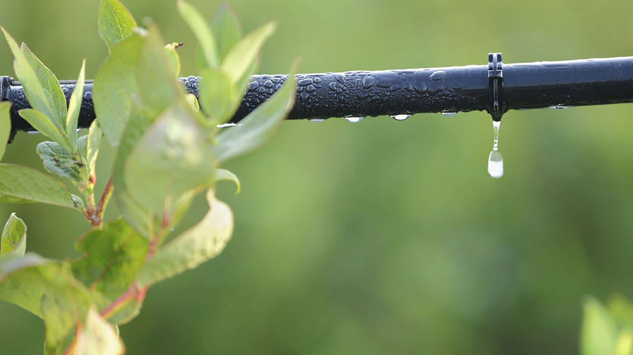
Materials for GSA Outreach May 2019

Slide 2
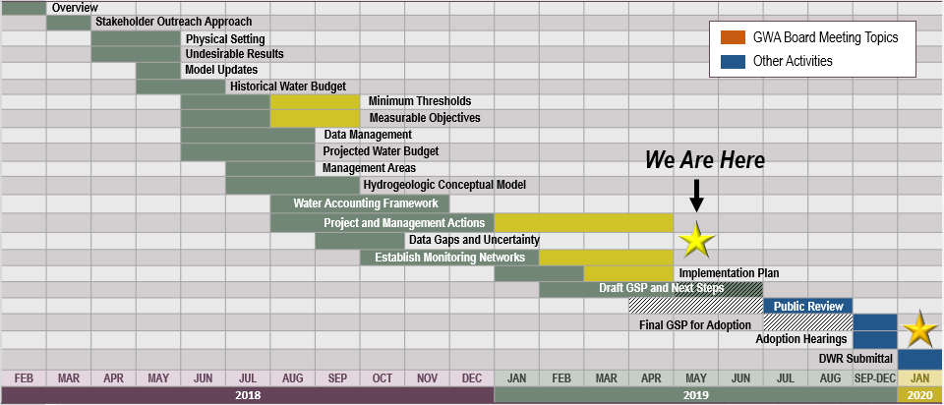
GSP Topics & Project Schedule
GSP Topics
GSP Finalization Elements
2

Slide 3
Water Budget Planning Estimates

Slide 4
What is Sustainable Yield?
Undesirable Results:
“Sustainable yield means the maximum quantity of water, calculated over a base period representative of long-term conditions in the basin and including any temporary surplus, that can be withdrawn annually from a groundwater supply without causing an undesirable result.”
California Water Code Section 10721
Chronic Lowering of Groundwater Levels
Reduction in Groundwater Storage
Seawater Intrusion
Degraded Water Quality
Land Subsidence
Depletion of Interconnected Surface Water
4

Slide 5
Board Action on Water Budget Planning Estimates
The GWA Board approved using the low-end estimate of long-term average groundwater pumping reductions needed to meet sustainable yield as the basis for developing an initial implementation plan (78,000 AFY).
The initial implementation plan will include projects and management actions aimed at using non-groundwater supplies in lieu of groundwater, reductions in total water demand, and / or increasing recharge to the groundwater basin to achieve sustainable yield by 2020.
Using the lower end estimate for the 2020 GSP will prevent over-planning projects in the 2020-2025 timeframe, while data is being collected and analyzed to further refine and verify sustainable yield estimates.
5

Slide 6
Sustainable Management Criteria

Slide 7
Staff Workshop Held on Sustainable Management Criteria
GSA Staff Workshop 4/3
Workshop Objectives:
Go over the details of the sustainable management criteria and projects and management actions
Identify policy decisions related to minimum thresholds, measurable objectives, monitoring network, and projects and management actions to be brought to Advisory Committee
These topics will be presented to the GWA Board in May
7

Slide 8
Overview of Six Sustainability Indicators
Chronic Lowering of Groundwater Levels
Reduction in Groundwater Storage
Seawater Intrusion
Degraded Water Quality
Land Subsidence
Depletion of Interconnected Surface Water
8

Slide 9
Board Action on Addressing Sustainability Indicators
The GWA Board voted to fully address all six sustainability indicators with minimum thresholds and measurable objectives. Where applicable, minimum thresholds and measurable objectives for groundwater levels can be used as a proxy for other sustainability indicators in accordance with DWR guidance.
9

Slide 10
Monitoring, Measuring and Model Refinements

Slide 11
Monitoring, Measuring, and Model Refinements
The following actions are required by SGMA:
Monitoring and reporting
Data collection and analysis
Administrative actions
5-year update
DMS updates
Public outreach
Website maintenance
Legal support
Grant writing
11

Slide 12
Board Action on Monitoring, Measuring, and Model Refinements
The GWA Board voted that measuring, reporting, and model verification and refinement activities be completed at the basin scale, as opposed to at the local GSA scale, subject to a financing plan with appropriate cost share allocations to be developed following GSP adoption.
12

Slide 13
Project Implementation
4

Slide 14
Board Action on Project Implementation
The GWA Board voted that projects in the GSP Implementation Plan be developed and implemented at the GSA level. This allows for GSAs to lead projects in their area and have full responsibility and authority regarding those projects as they typically do as an agency. GSAs with projects in the GSP may work with additional parties in the development of their projects, or may request that the JPA considers implementing projects on their behalf, at its sole discretion.
14

Slide 15
Outreach & Groundwater Sustainability Workgroup Update

Slide 16
Groundwater Sustainability Workgroup Update
7 Workgroup members and 3 members of the public attended the Groundwater Sustainability Workgroup meeting held on April 10th
The next Workgroup meeting will be held on May 8th at 4:00pm at the San Joaquin County Public Works Department
Notes from Workgroup meeting are available on the website, esjgroundwater.org (under ‘Agendas’ tab)
The April Workgroup focused on sustainability indicators and undesirable results, along with monitoring network
16

Slide 17
Groundwater Sustainability Workgroup Update
17

Slide 18
DWR Update

Slide 19
Technical Support Services Funding Update
DWR’s Technical Support Services (TSS) provides funding to construct monitoring wells in areas where data gaps exist.
The TSS application for the Eastern San Joaquin Subbasin has been approved to go to the next level, and the formal agreement is underway.
19

